Slide 1
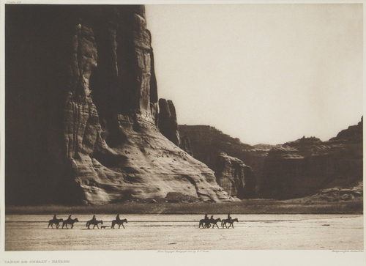
Canyon De Chelly - Navaho
Edward S. Curtis 1868-1952
Acquisition Number: 76.16 Medium: Size: 11 1/4" x 15 1/4" Date: 1904
Canyon De Chelly - Navaho
Edward S. Curtis 1868-1952
Size: 11 1/4" x 15 1/4" Date: 1904
Notes:
Canyon/plateaus… clearly not in Ohio ☺
Canyon De Chelly has been called home for over 5,000 years, starting with ancient Puebloans, to Hopi, to the Navajo. The Navajo people live there today.

Slide 2
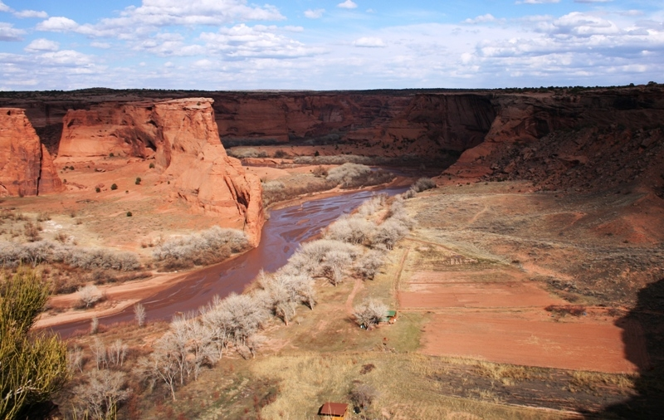
Canyon De Chelly
Notes:
Canyon De Chelly Today

Slide 3
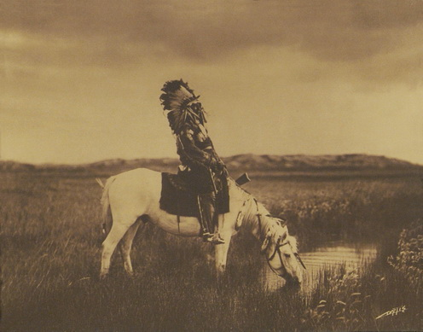
Oasis in the Badlands
Edward S. Curtis 1868-1952
Acquisition Number: 2001.3 Medium: Size: 10 1/2" x 13 1/2" Date: c. 1905
Notes:
grasslands/plains

Slide 4
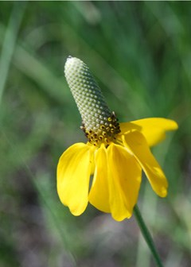
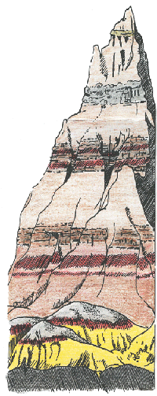
The Badlands half geologic formations, half prairie
Info and photos from NPS.gov/badl
Notes:
Ankle to waist high grasses meet stark geologic formations created from deposited layers of earth that were then eroded away to reveal those layers. More than 400 species of plants in the grassy area!

Slide 5
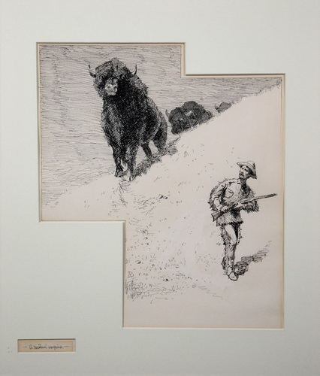
Mutual Surprise
Frederic Remington 1861-1909
Acquisition Number: 61.10 Medium: Size: 12 1/4" x 10 1/4" Date: n.d.
Notes:
Grassy plains….
At the age of 19, he learned to throw a lariat and handle a six gun like a master. He wandered through the states and territories riding with wagon trains as a hired cowboy. He spent time in encampments of Indian tribes. One night an old wagon freighter talked to him about how the Old West was changing and soon it would be no more. This set Remington to thinking and he decided to record the Old West as he saw it. On his trips to the West, Remington collected articles and clothing used by hunters, trappers, cowboys and Indians. He kept these in his studio so that if any detail of a sketch made in the field raised questions in his mind, He could check with the original. When Remington decided to sculpt, he drew from contemporary history the most picturesque of American People, the unheralded people of the land. By 1895, Remington was recognized as one of the worlds’ foremost experts in art of our wild westerns scenes

Slide 6
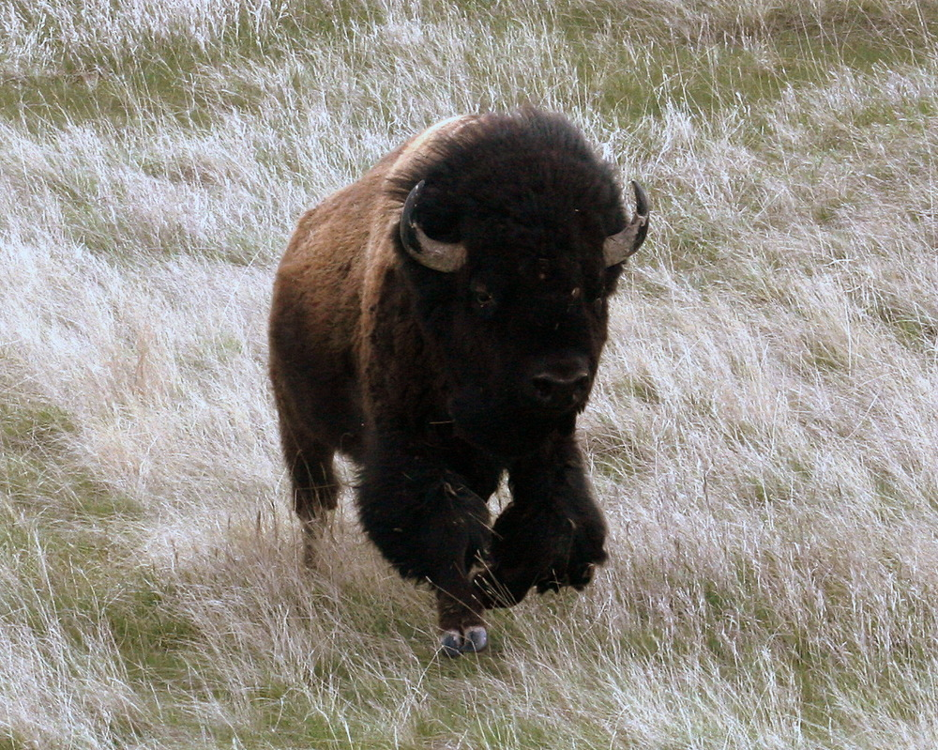
https://www.nps.gov/media/photo/gallery.htm?id=5981E181-155D-4519-3E44C12FD735B27B
Notes:
At the badlands national park- prairie portion

Slide 7
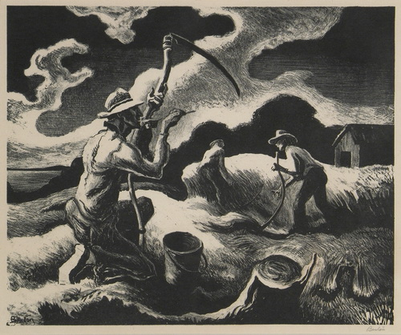
Acquisition Number: 84.50 Medium: Size: 9 3/4" x 12 1/2" Date: 1946
Island Hay
Thomas Hart Benton 1889-1975
Notes:
Developed/farming on the prairie

Slide 8
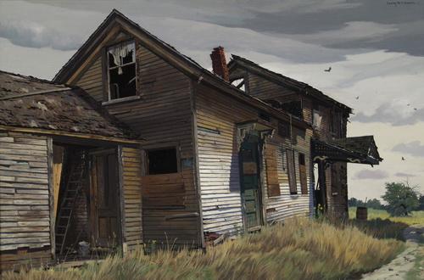
Acquisition Number: 60.13 Medium: Size: 38 1/2" x 25 1/4" Date: 1958
Yesterday and Before and Before
Loring W. Coleman 1918-2015
Notes:
Sometimes things painted or made in the present can tell us about the past. The grasslands are growing up again around this abandoned house…

Slide 9
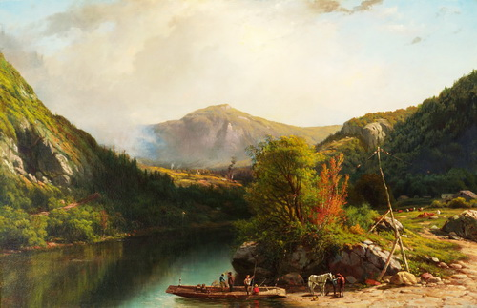
Ferry Crossing
George L. Clough 1824-1901
Acquisition Number: 80.14 Medium: Size: 36" x 56" Date: 1901
Ferry Crossing
George L. Clough 1824-1901
Size: 36" x 56" Date: 1901
Notes:
Mountain lands

Slide 10
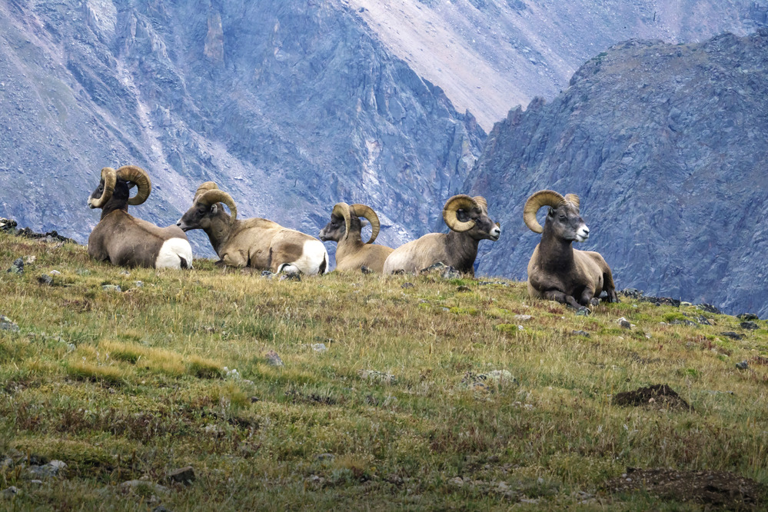
Bighorn rams on the tundra Credit: NPS Photo
https://www.nps.gov/media/photo/gallery.htm?id=016D0F70-1DD8-B71B-0BF43FF8619649E6
Notes:
Rocky Mountain National Park

Slide 11
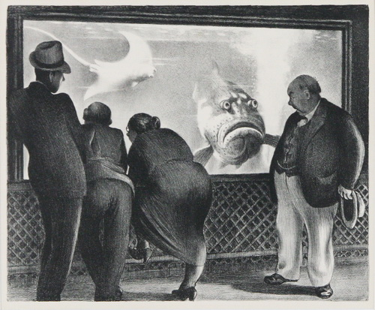
Queer Fish
Mabel Dwight 1876-1955
Acquisition Number: 60.23.J Medium: Size: 10 1/2" x 13" Date: 1936
Queer Fish
Mabel Dwight 1876-1955
Size: 10 1/2" x 13" Date: 1936
Notes:
“Ocean” we have to look at aquariums, or scuba dive, snorkel or take a submarine to see what is under the ocean

Slide 12
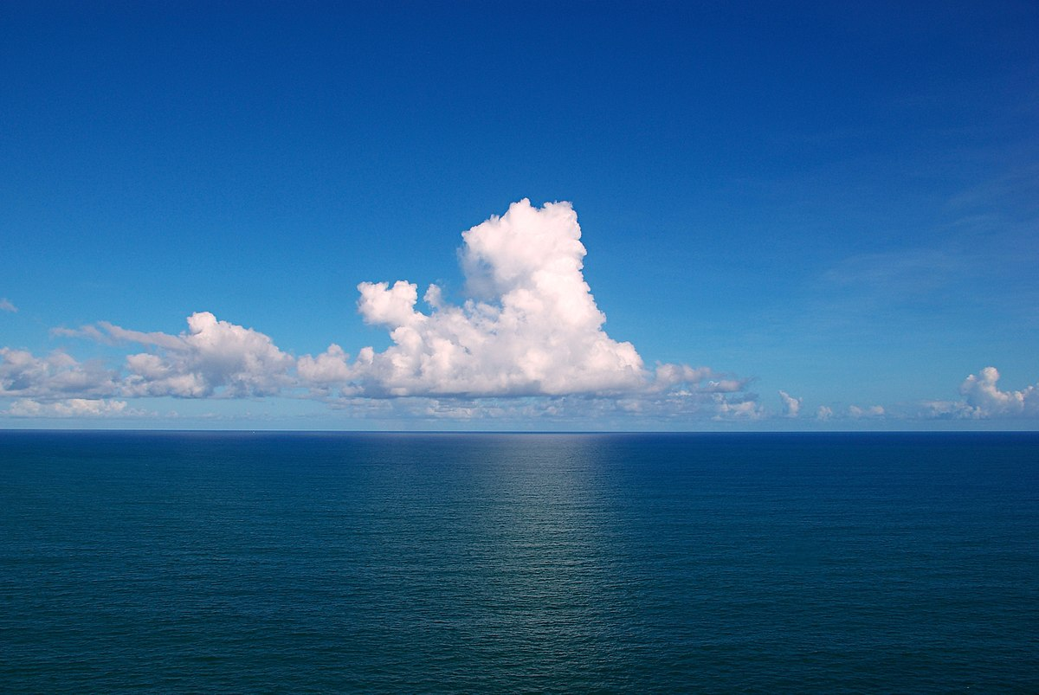
https://commons.wikimedia.org/wiki/File:Clouds_over_the_Atlantic_Ocean.jpg#/media/File:Clouds_over_the_Atlantic_Ocean.jpg
Notes:
Unless we do those things, this is our usual view. Thank goodness for all of the explorers and divers who have gone and documented their trips so that we can know what all is in the ocean, and where!

Slide 13
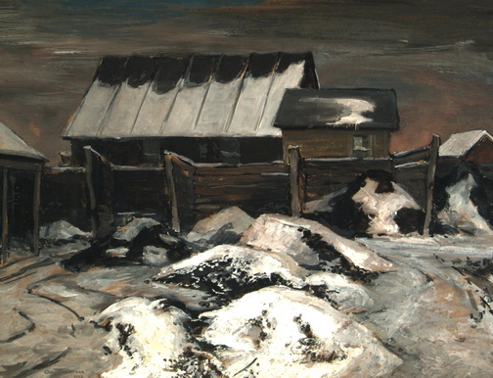
Coal Yard #2
Carl Gaertner 1898-1952
Acquisition Number: 2010.10 Medium: Size: 22" x 29 3/4" Date: 1942
Notes:
Cave: (slash mine)
What about those landforms that are under the ground? While caves and caverns are not shown in this exhibition, we can see an image of a coal yard here. This coal yard shows the surface of the earth, with sooty snowbanks and other clues to the existence of coal industry.

Slide 14
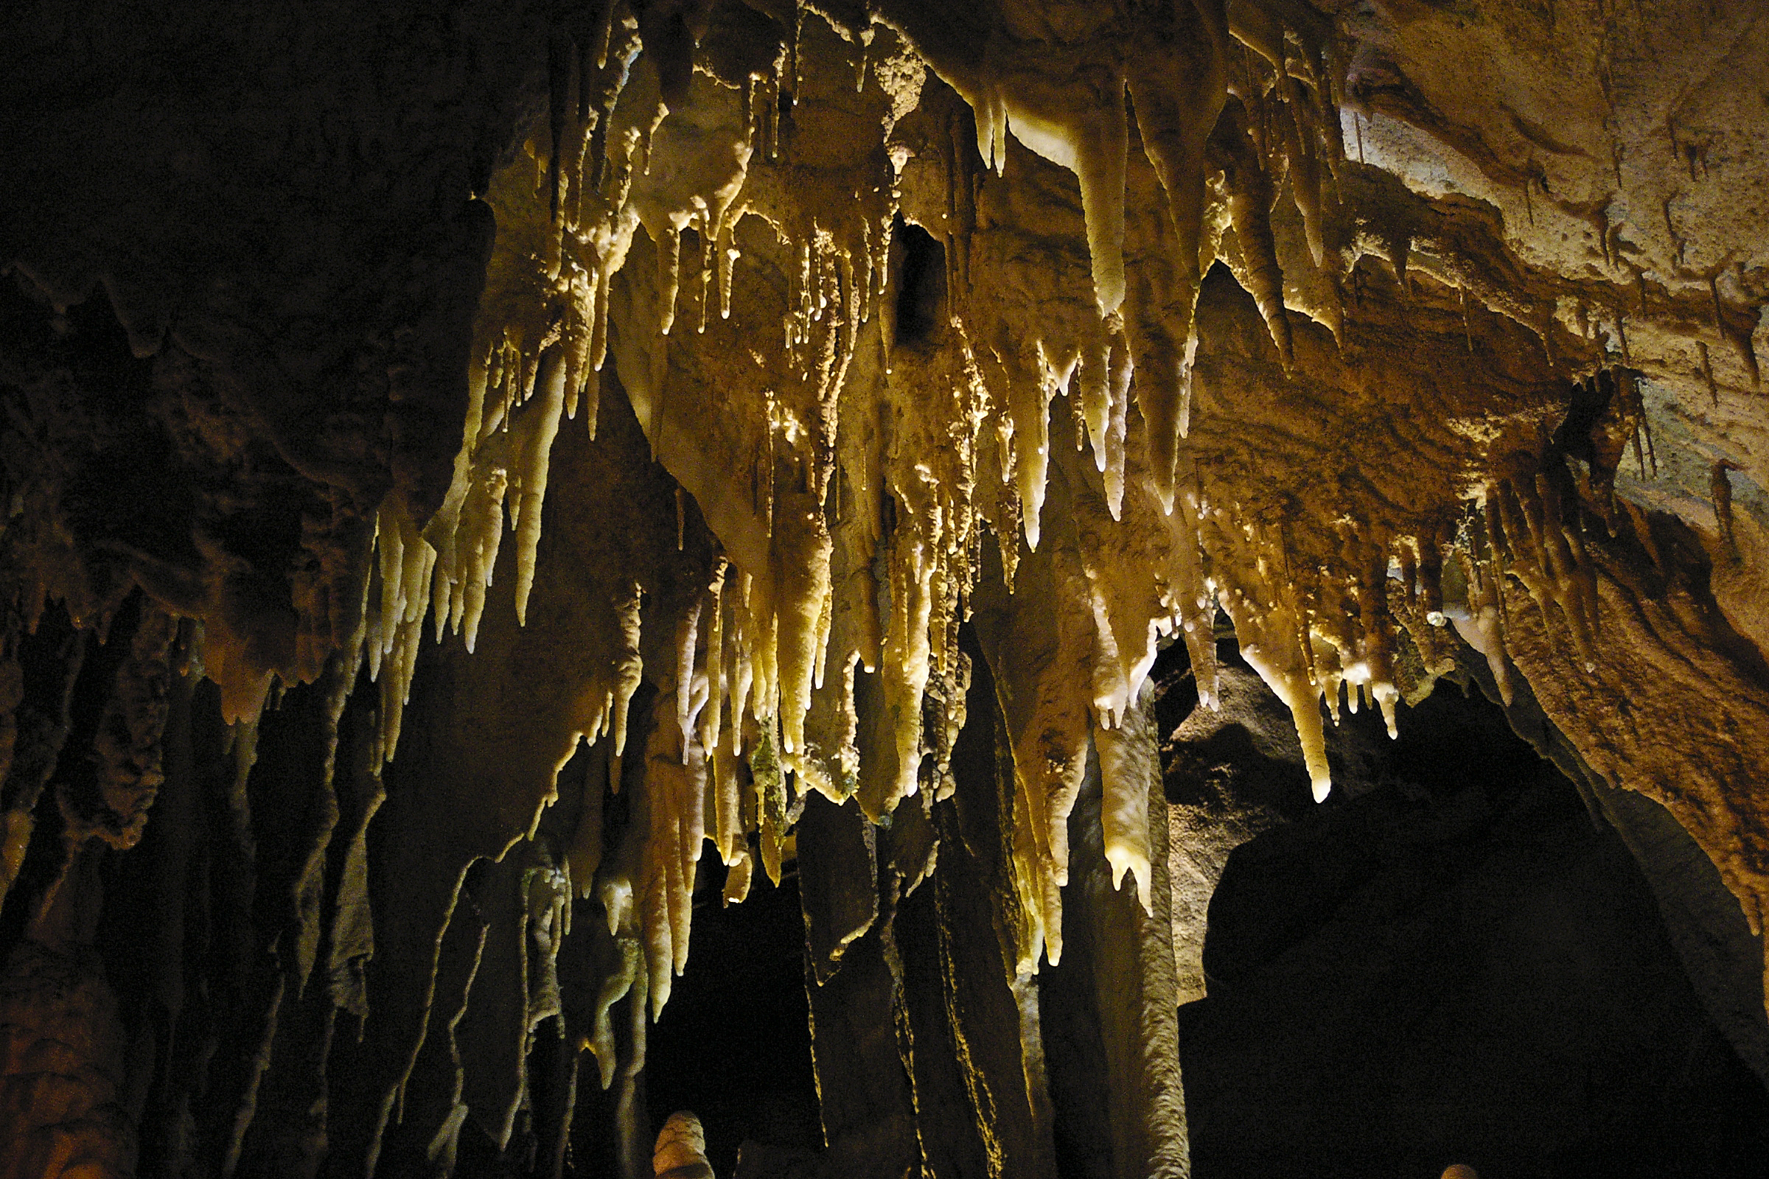
Images from NPS- Mammoth Cave
Notes:
Caves, which may be seen as recreational/vacation spots and areas of geologic interest today, were often utilized as a means for mining for resources. Native Americans, the first discovers of Mammoth Cave, and for 2,000 years mined the cave for minerals such as gypsum. Woven moccasins, torches, shells and pottery have all been found in the cave, well preserved under the surface of the earth. When (re) discovered by Europeans in the 1800s, it became utilized for the mining of calcium nitrate which was used to create gunpowder. Slaves were forced to mine and process the resources in the cave. During the War of 1812, the gunpowder made here kept the United States free, but not everyone in the United States was free- including the miners who helped supply a key ingredient for that gunpowder.

